Slide 1
Object-Oriented Design
Final Presentation
Professor - Jones Yu
Team High Five
Henan Mu (002783324)
Prachi Deepak Kunjir (002197614)
Sai Saran Pathuri (002968508)
Sai Siddhartha Kondamu (002961108)
Yuxuan cheng, (002773368)

Slide 2
Project Overview
To incorporate all of the Object-Oriented Programming ideas with JavaFx that we learned throughout the course, we wanted to create something entertaining and engaging. We thought there was no better approach than to create a game that everyone enjoys.

Slide 3
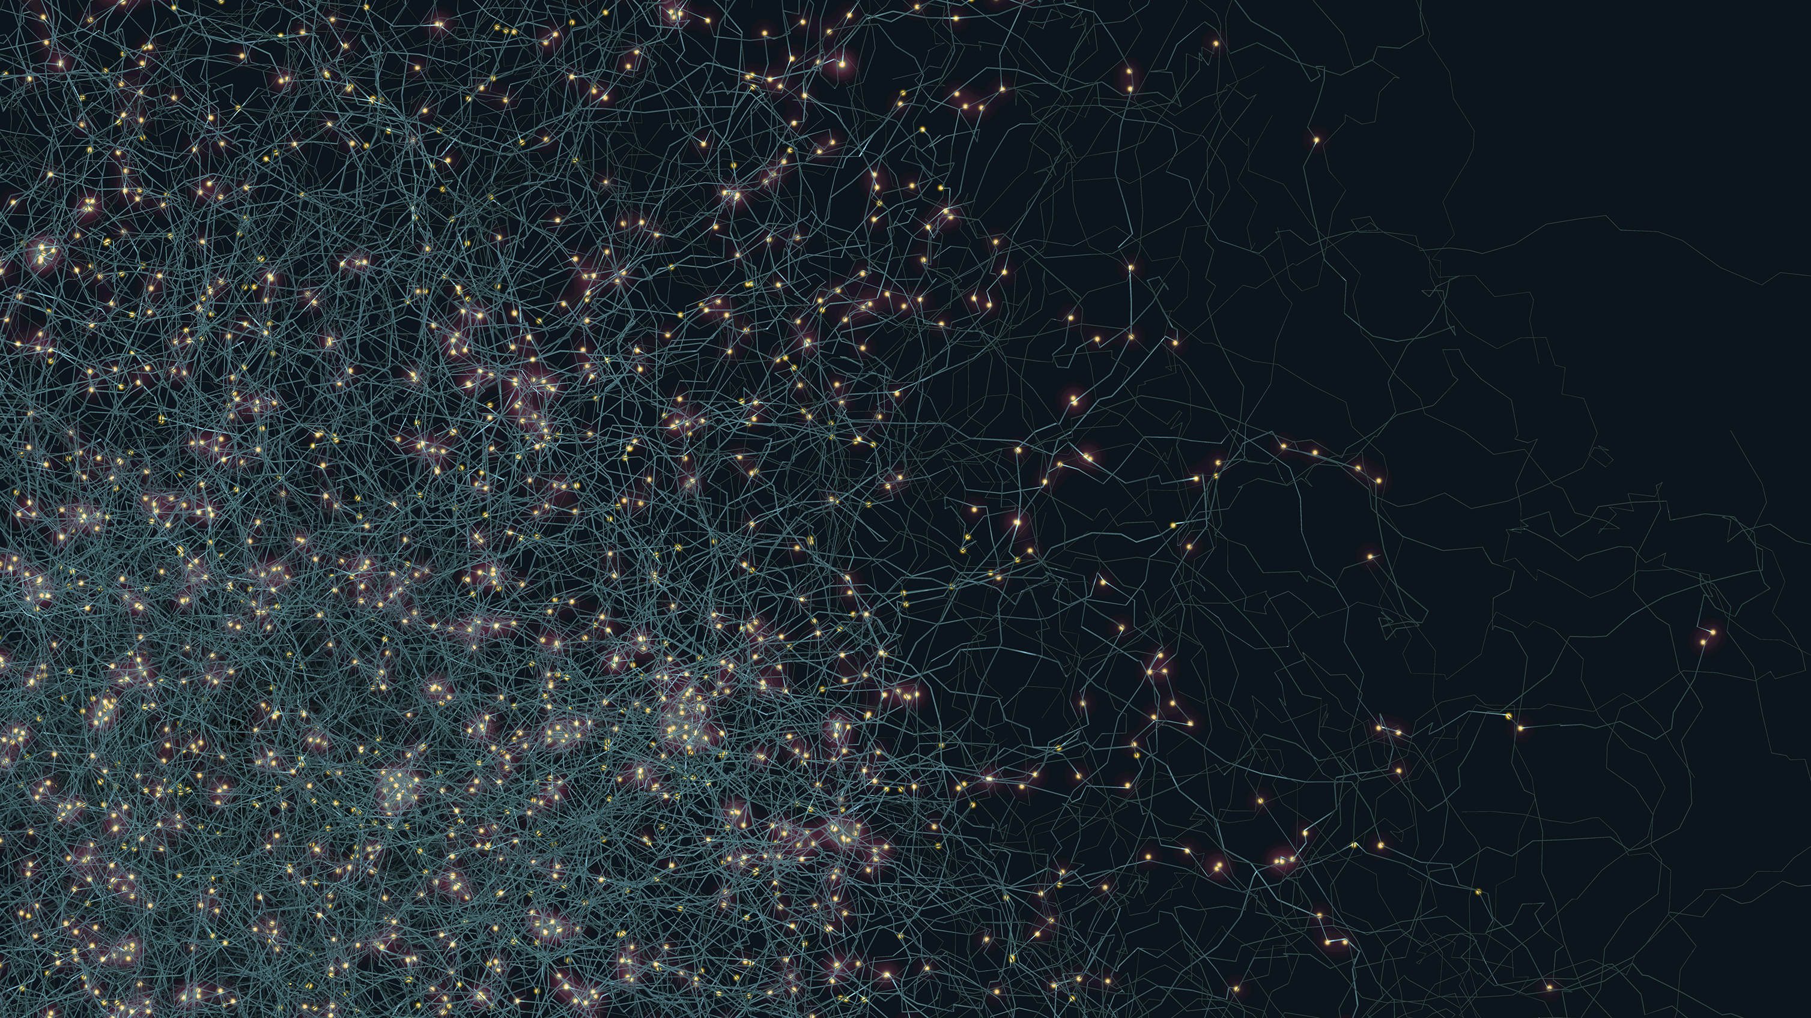
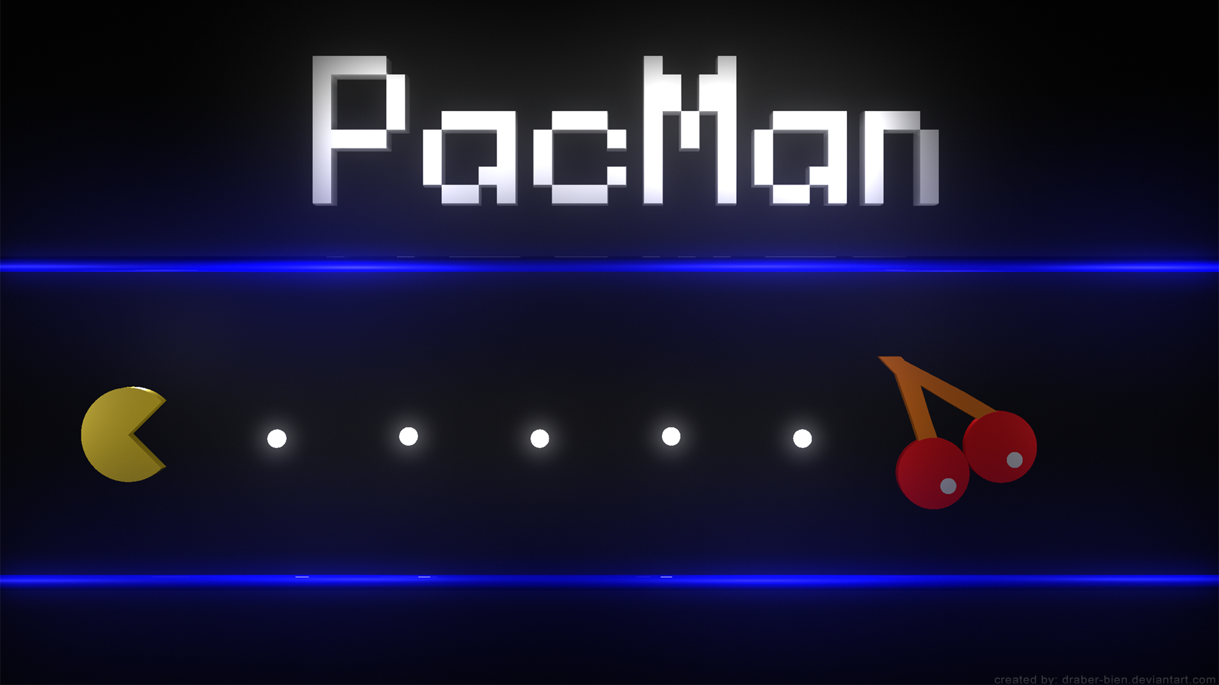
Solution and Inspiration
We are inspired by the game Pacman. While the game seems very straight forward the application of the concepts was quite fascinating.
It's not the traditional pacman that you're familiar with.
It's Pacman in Space.
This Photo by Unknown author is licensed under CC BY-SA-NC.

Slide 4
How we work together
Bi-Weekly meetings
Check progress regularly
Set goals or make decisions together
Tested and fixed bugs

Slide 5
Contributions
Henan Mu: Component diagram, worked on game dynamics, mainly concentrated on collision between Pac-Man and stars, also worked on Credits subscene in the dashboard
Prachi Deepak Kunjir: Created moving background for the game and worked on moving the Pac-Man according to keys pressed, and also the Help Section in the dashboard.
Sai Saran Pathuri: Worked on game dynamics, mainly concentrated on collision between ghosts and Pac-Man; researched about assets online to match our requirements
Sai Siddhartha Kondamu: UML Diagram, customized labels, button, subscenes, and ImageViews for the game and worked on generating ghosts at random intervals at random positions
Yuxuan Cheng: Worked on reading player names and updated scores in the file, and dynamically updating the scores and lives of player in the game.

Slide 6

Concepts covered in the project
We have extensively used the following topics
Class Definition
Inheritance and Polymorphism
Interfaces
Collections and Iterators
Lists
Sets

Slide 7
Workflow
Start
Main Page
Create
Submit
Play
Game Page
Scores
Get History Scores
Help
Credits
Exit
Save Scores
Close

Slide 8
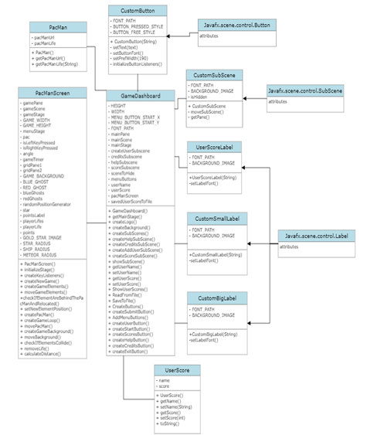
UML Diagram

Slide 9
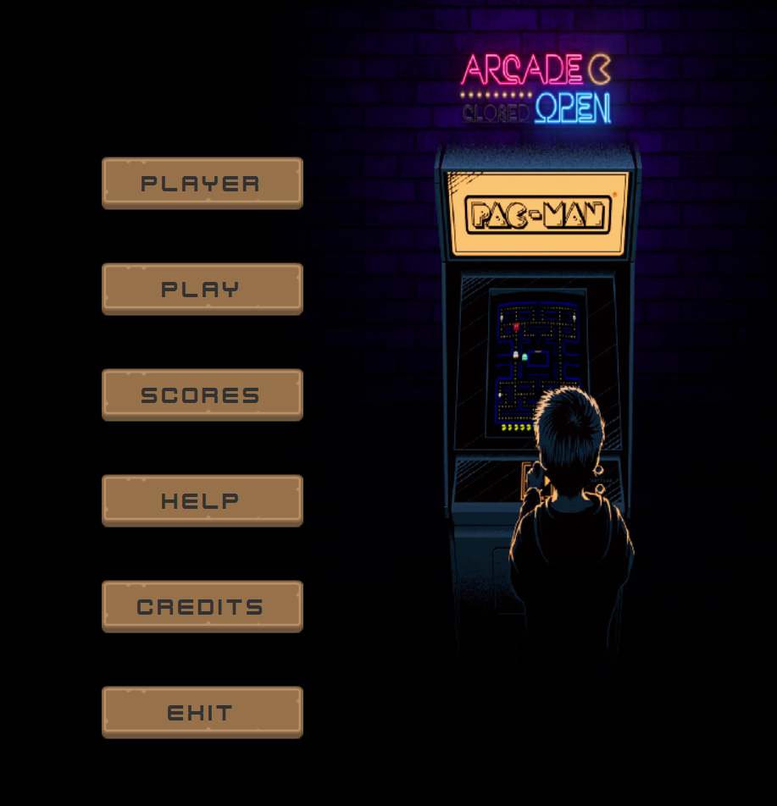
Design and Implementation
Stage
Scene
Layout (AnchorPane, GridPane)
Controls – (Buttons, Images, TextFields, Labels, VBox)
Customized the Background using Image and ImageView.
Customized the buttons by extending the Button class in JavaFx to set custom font, width, height, and background to each of the buttons used.

Slide 10
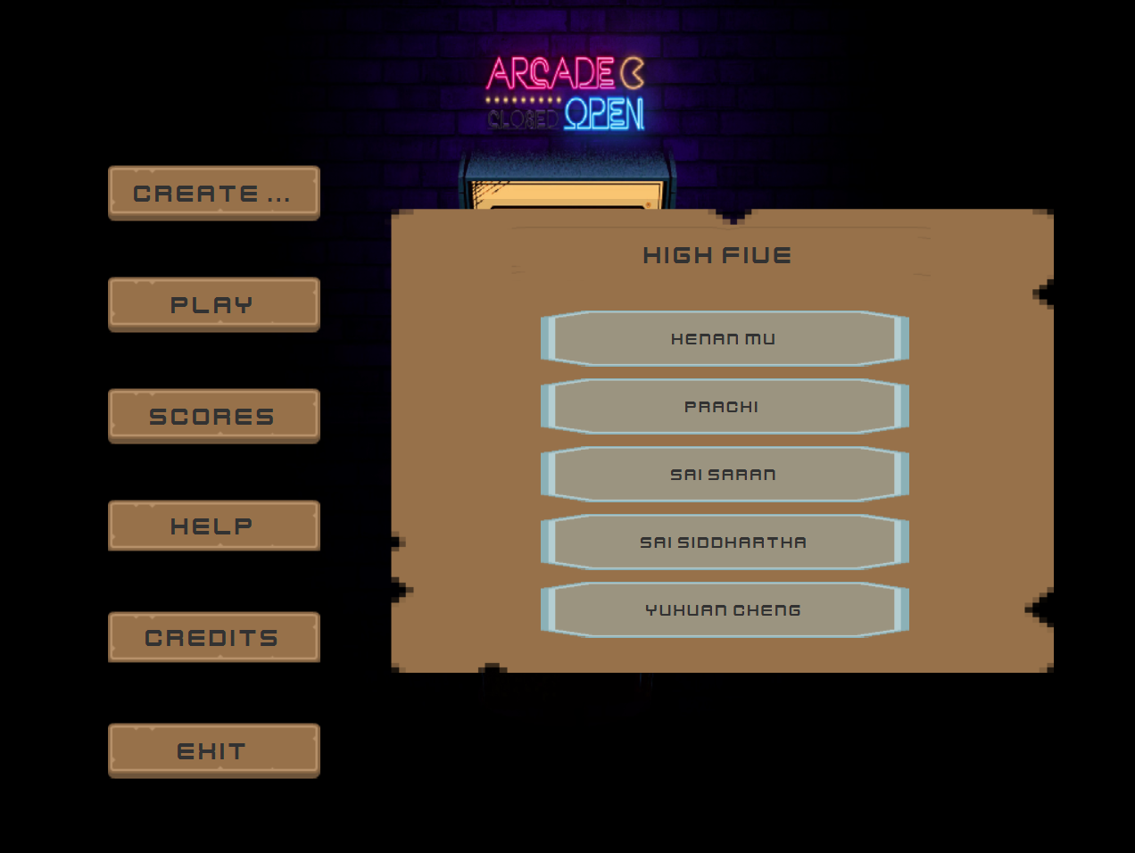
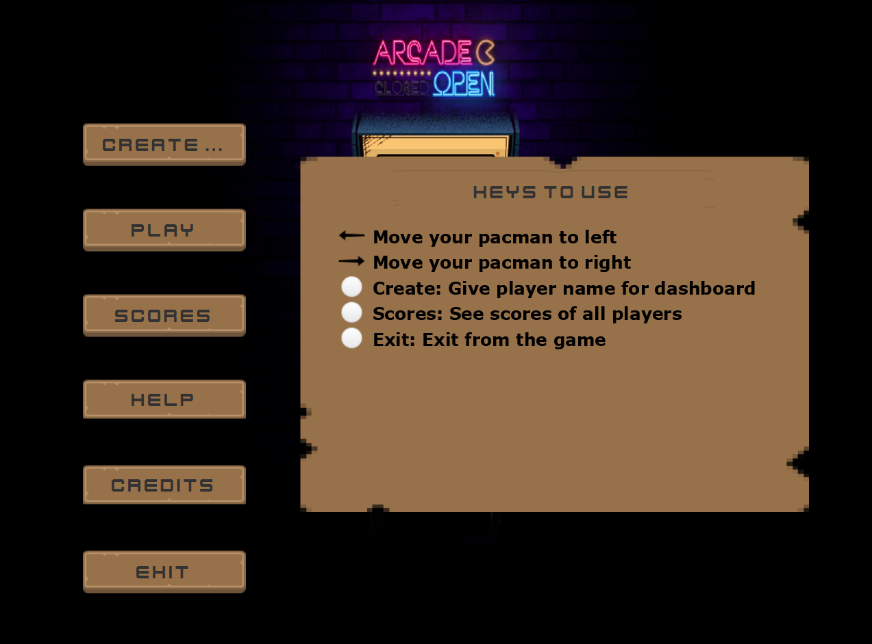
Continuation...
Extended the SubScene class in JavaFx to create custom subScenes with custom background.​
Customized the Labels by extending the Label class in JavaFx to set custom fonts and background.
Ability to show and hide a SubScene based on the button the user has clicked​.
Added transition styling to the SubScenes using the TranslateTransition class in JavaFx.

Slide 11
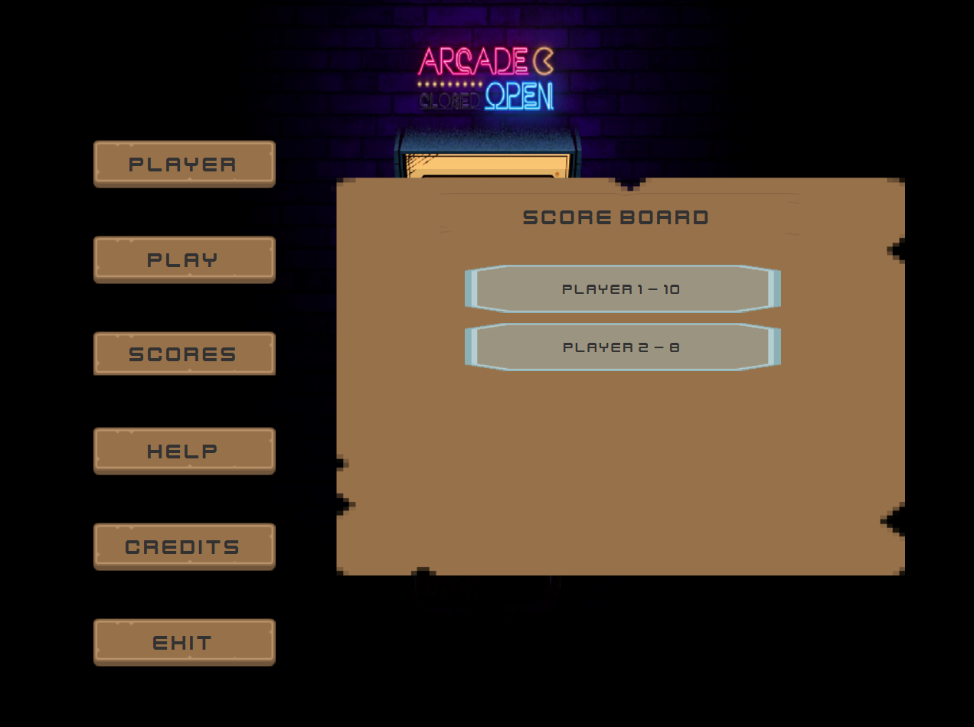
Inquire & show scores
Defines UserScoreLabel class inherits Label.
Read LeaderBoard.txt. Read it by lines.
Store the lines into an arraylist.
New a vbox. For each element in arraylist, use a UserScoreLabel to display.

Slide 12
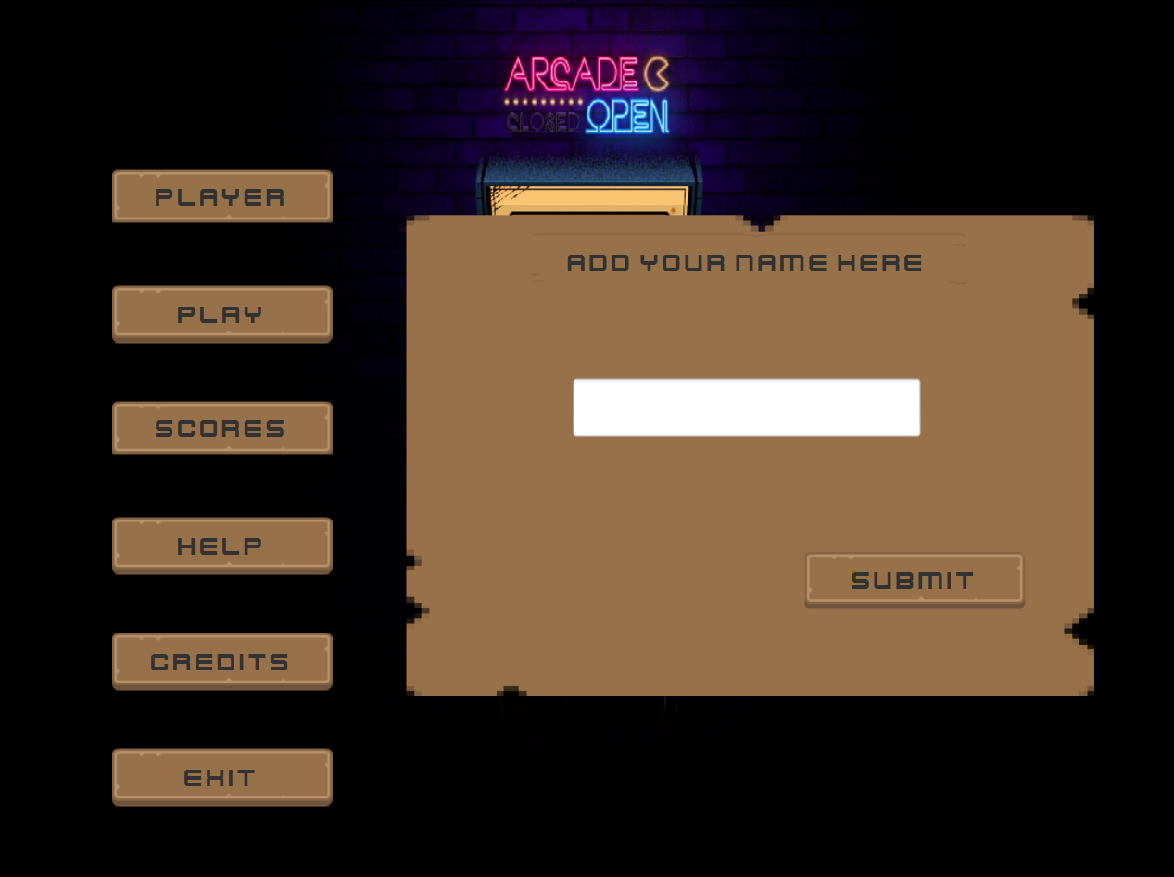
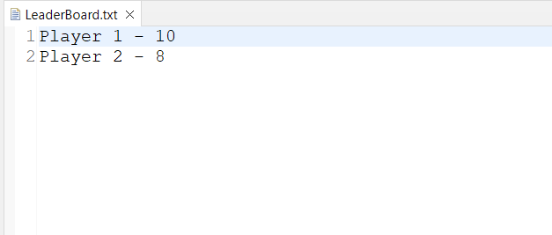
Create & save user scores
Initialize: set initial name 'Player'.
Modify:
Click 'create' --> typing --> 'submit' to save a name
Click exit --> name and score updated & saved in LeaderBoard.txt

Slide 13
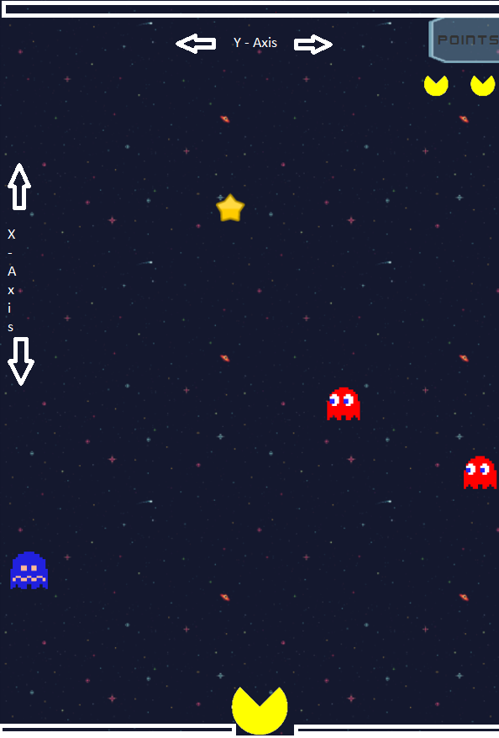
Game Elements Generation
Spirits or Ghosts are place generated by adding to the pane
By using randomPositiongenerator the "X" and "Y" coordinates are generated.
The randomly generated elements are moved five pixel's on every refresh of the animation.
When ever the elements reaches the end of the pane, they'll start again from top with new random positions

Slide 14
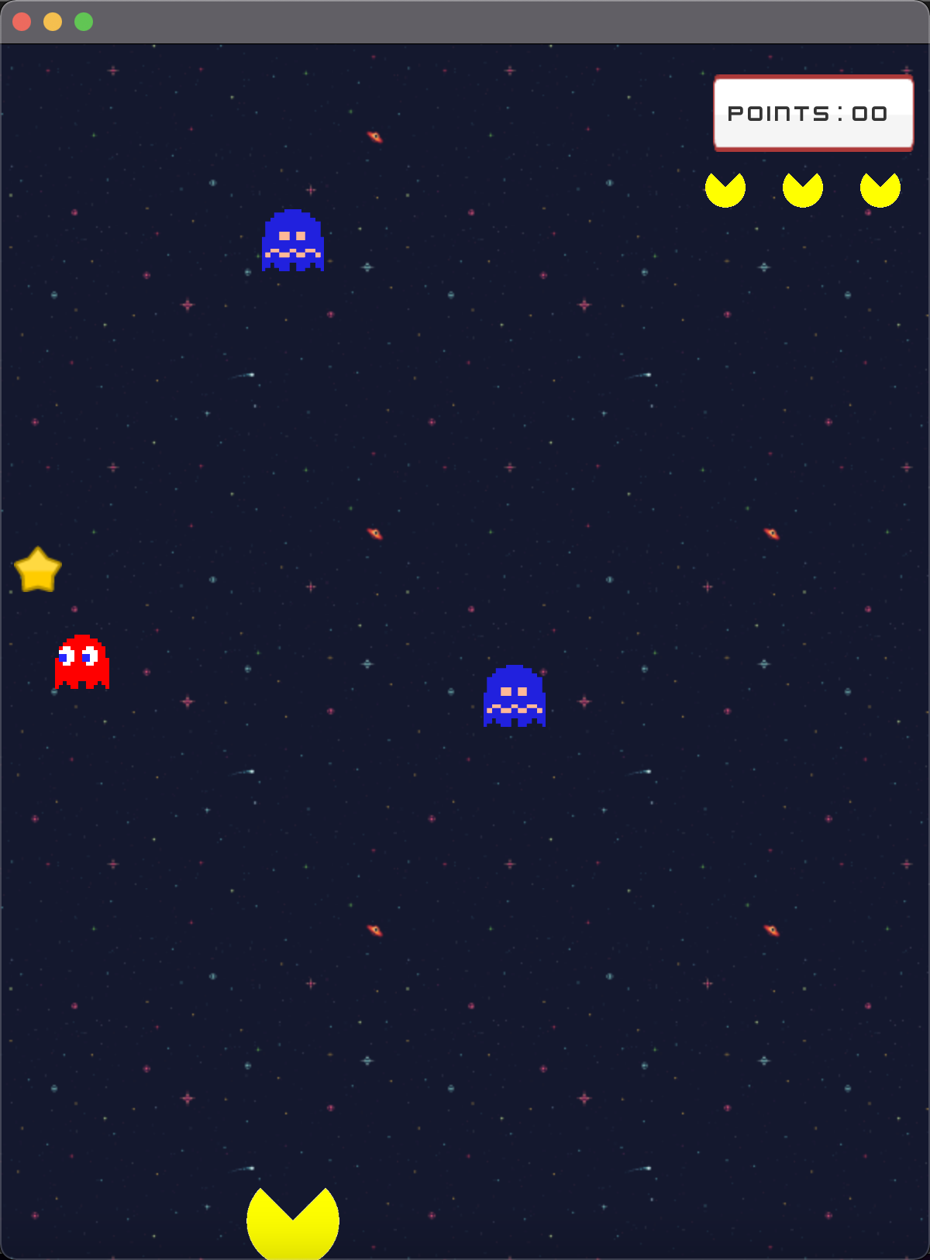
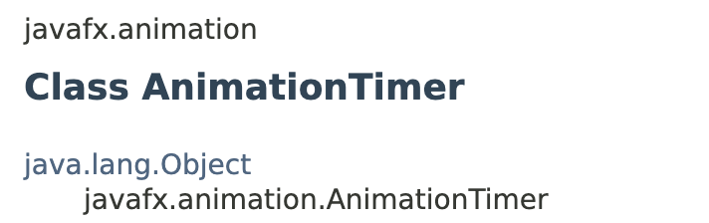
Class GameManagerView
By now, every elements of this game are on the stage but they are stationary. We need to make them move, start the game loop
The class AnimationTimer allows to create a timer, that is called in each frame while it is active. An extending class has to override the method handle(long) which will be called in every frame. The methods start() and stop() allows to start and stop the timer.

Slide 15

Moving Background
We used png image and manipulated its Y coordinates to give effect of moving vertically
We created two grid panes and used two same images.
We are setting its coordinates with setconstraints and adding these two panes to main game pane

Slide 16



Moving Pacman
We are using keyboard events to check which key is pressed.
Here we have used 3 cases:
1. When left key is pressed and right key is not pressed - To move the pacman to left we are checking if the left key is pressed and if its angle is >-30 then we are adding –5 to show that its moving left.
2. When left key is not pressed and right key is pressed
3. When left key and right key are not pressed or when left key and right key are pressed – Don't move pacman

Slide 17
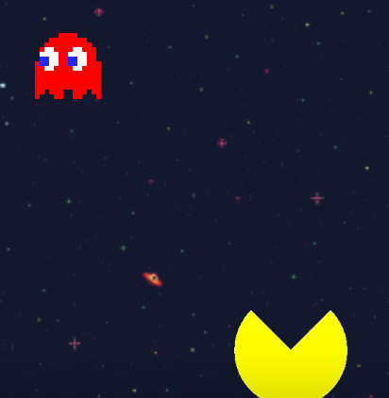
Collision
Check elements collide:
Pacman collides with ghost
Pacman collides with star
Distance
We use an expression to detect collision:
(distance of pacman and external_elements < pacman.radius + external_elements s.radius)
When collision happens, the ghost or star do not disappear, we relocate ghost or star

Slide 18

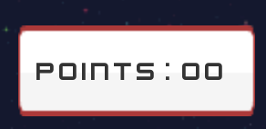
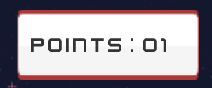
Collide with star -> Score incrementation
Pacman collides with star
Update score label

Slide 19



Collide with ghost -> Lose user lives
Pacman collides with ghost
User has three user lives
Lose user lives (remove ImageView from pane)
When all the user lives are gone
The game is over
We close the game page and go back to the main page

Slide 20
Future Improvements and Conclusion
PDF download feature for scoreboard
Email notifications to winners
Online multiplayer game
More animations

Slide 21
THANK YOU!!

